Slide 1

OPERATING SYSTEMS
Computer-System Architecture,
OS Structure and Operations
Suresh Jamadagni
Department of Computer Science

Slide 2

OPERATING SYSTEMS
Slides Credits for all the PPTs of this course
The slides/diagrams in this course are an adaptation, combination, and enhancement of material from the following resources and persons:
Slides of Operating System Concepts, Abraham Silberschatz, Peter Baer Galvin, Greg Gagne - 9th edition 2013 and some slides from 10th edition 2018
Some conceptual text and diagram from Operating Systems - Internals and Design Principles, William Stallings, 9th edition 2018
Some presentation transcripts from A. Frank – P. Weisberg
Some conceptual text from Operating Systems: Three Easy Pieces, Remzi Arpaci-Dusseau, Andrea Arpaci Dusseau

Slide 3
OPERATING SYSTEMS
Computer-System Architecture,
OS Structure & Operations
Suresh Jamadagni
Department of Computer Science

Slide 4
OPERATING SYSTEMS
Computer-System Architecture
Most systems use a single general-purpose processor
Most systems have other special-purpose processors as well.
Device specific processors like disk, keyboard, graphic controller
Special-purpose processors run a limited number of instructions
Special-purpose processors are low-level components built into the hardware
Managed by OS.
OS monitors the status.
Example Disk controller microprocessor
Receives sequence of requests from CPU.
Implements its own disk queue and scheduling algorithm
Relieves the main CPU of the overhead of disk scheduling.

Slide 5
OPERATING SYSTEMS
Computer-System Architecture
Multiprocessors systems growing in use and importance
Also known as parallel systems, tightly-coupled systems
Advantages include:
Increased throughput
Economy of scale
Increased reliability – graceful degradation or fault tolerance

Slide 6
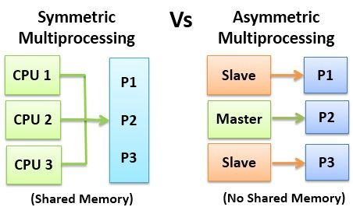
OPERATING SYSTEMS
Multiprocessors
Two types of Multiprocessor Systems
Asymmetric Multiprocessing – each processor is assigned a specific task.
Symmetric Multiprocessing – each processor performs all tasks

Slide 7
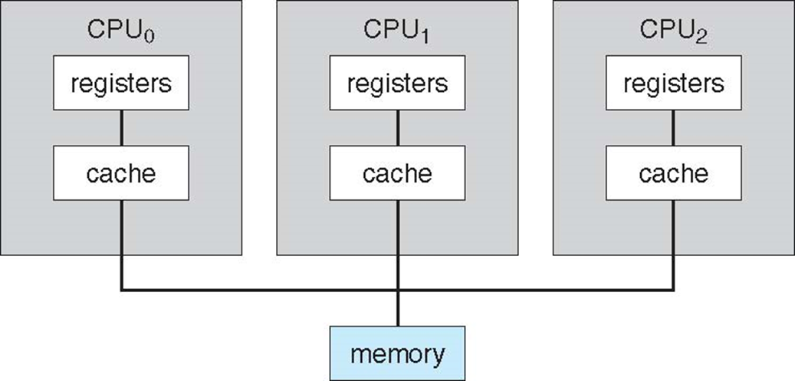
OPERATING SYSTEMS
Symmetric Multiprocessing Architecture
In SMP all processors are peers; no boss–worker relationship exists between processors.
Each processor has its own set of registers, as well as a private or local cache.
All processors share physical memory.

Slide 8
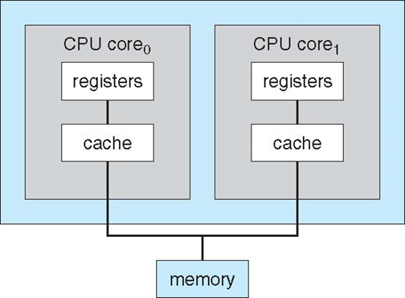
OPERATING SYSTEMS
Multi-Core Design
A recent trend in CPU design is to include multiple computing cores on a single chip. Such multiprocessor systems are termed multicore.
More efficient than multiple chips with single cores because on-chip communication is faster than between-chip communication.
One chip with multiple cores uses significantly less power than multiple single-core chips.
A dual-core design with two cores placed on the same chip
Command to know the number of cores, cache details
$cat /proc/cpuinfo|more

Slide 9
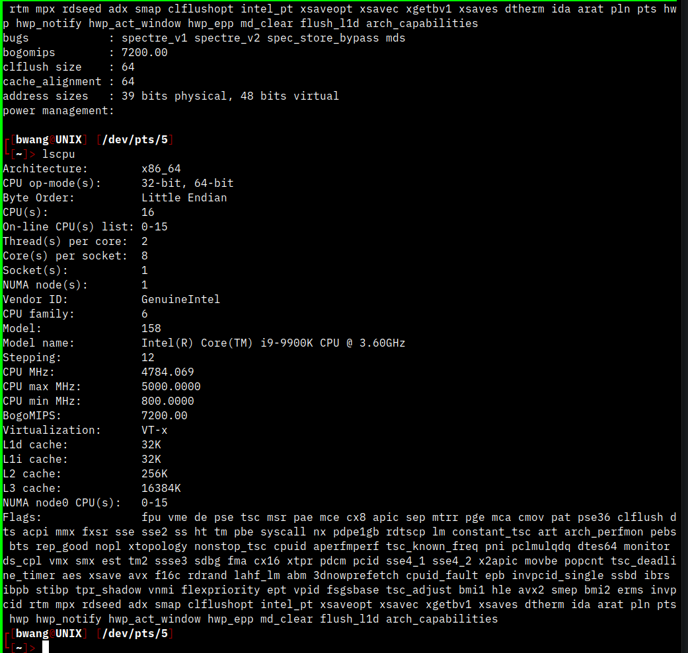
OPERATING SYSTEMS
Multi-Core Design
Command to know the number of cores, cache details
$more /proc/cpuinfo

Slide 10
OPERATING SYSTEMS
Blade servers
Blade servers are a recent development in which multiple processor boards, I/Oboards, and networking boards are placed in the same chassis.
blade-processor board boots independently and runs its own operating system.
Some blade-server boards are multiprocessor as well, which blurs the lines between types of computers.
In essence, these servers consist of multiple independent multiprocessor systems.

Slide 11
OPERATING SYSTEMS
Clustered Systems
Like multiprocessor systems, but multiple systems working together
Usually sharing storage via a storage-area network (SAN)
Provides a high-availability service which survives failures
Asymmetric clustering has one machine in hot-standby mode
Symmetric clustering has multiple nodes running applications, monitoring each other
Some clusters are for high-performance computing (HPC)
Applications must be written to use parallelization
Some have distributed lock manager (DLM) to avoid conflicting operations (Ex: when multiple hosts access the same data on shared storage)

Slide 12
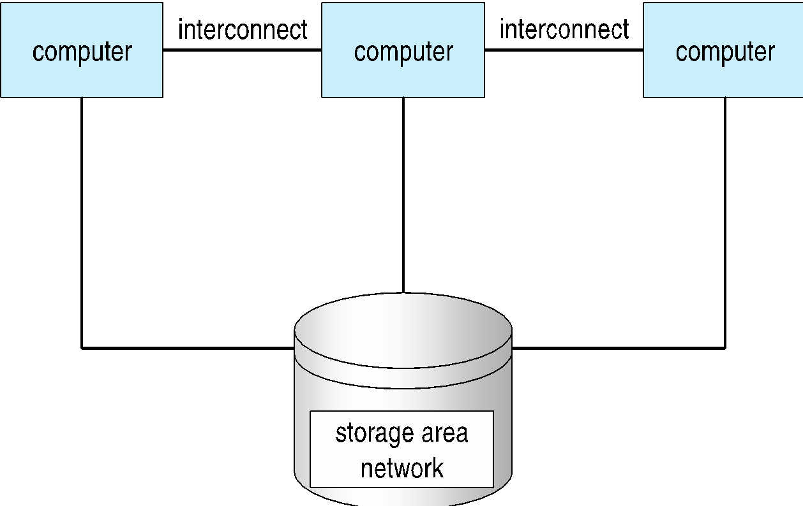
OPERATING SYSTEMS
Clustered Systems
SAN allow many systems to attach to a pool of storage
General structure of a clustered system.

Slide 13
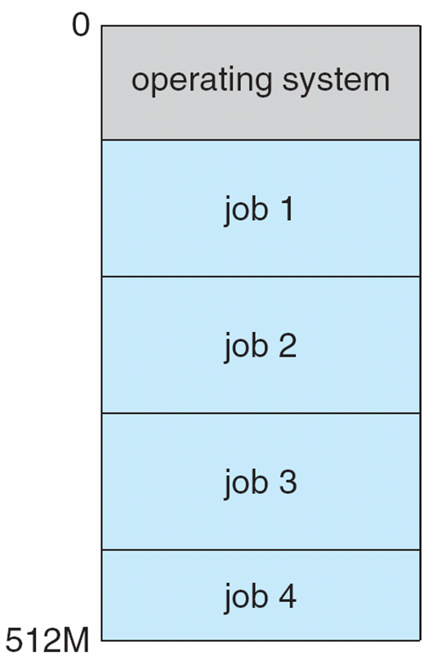
OPERATING SYSTEMS
Operating-System Structure - Multiprogramming
Multiprogramming (Batch system) needed for efficiency
Single user cannot keep CPU and I/O devices busy at all times
Multiprogramming organizes jobs (code and data) so CPU always has one to execute
A subset of total jobs in system is kept in memory
One job selected and run via job scheduling
When it has to wait (for I/O for example), OS switches to another job

Slide 14
OPERATING SYSTEMS
Operating-System Structure - Multitasking
Timesharing (multitasking) is logical extension in which CPU switches jobs so frequently that users can interact with each job while it is running, creating interactive computing
Response time should be < 1 second
Each user has at least one program executing in memory 🢡process
If several jobs ready to run at the same time 🢡 CPU scheduling
If processes don’t fit in memory, swapping moves them in and out to run
Virtual memory allows execution of processes not completely in memory

Slide 15
OPERATING SYSTEMS
Operating-System Operations
Interrupt driven (hardware and software)
Hardware interrupt by one of the devices
Software interrupt (exception or trap):
Software error (e.g., division by zero)
Request for operating system service
Other process problems include infinite loop, processes modifying each other or the operating system

Slide 16
OPERATING SYSTEMS
Dual-Mode and Multimode Operation
Dual-mode operation allows OS to protect itself and other system components
User mode and kernel mode
Mode bit provided by hardware
Provides ability to distinguish when system is running user code or kernel code
Some instructions designated as privileged, only executable in kernel mode
System call changes mode to kernel, return from call resets it to user
Increasingly CPUs support multi-mode operations
i.e. virtual machine manager (VMM) mode for guest VMs

Slide 17
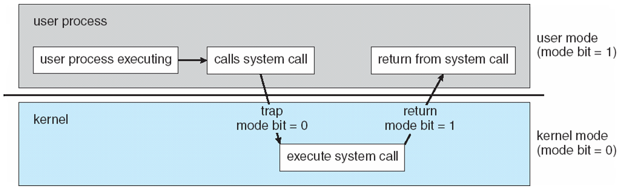
OPERATING SYSTEMS
Transition from user to kernel mode
When a trap or interrupt occurs, hardware switches from user mode to kernel mode (changes the state of the mode bit to 0).
When the request is fulfilled, the system always switches to user mode (by setting the mode bit to 1) before passing control to a user program.

Slide 18
OPERATING SYSTEMS
Timer
Timer to prevent infinite loop / process hogging resources
Timer is set to interrupt the computer after a specified period (fixed 1/60 sec or variable 1 msec to 1 sec)
A variable timer is generally implemented by a fixed-rate clock and a counter.
Operating system sets the counter (privileged instruction)
Every time the clock ticks, the counter is decremented.
When counter reaches zero, an interrupt occurs
Timer can be used to prevent a user program from running too long (terminate the program)

Slide 19
THANK YOU
Suresh Jamadagni
Department of Computer Science Engineering
sureshjamadagni@pes.edu

